Slide 1
Measuring a Nation’s Income

Slide 2
Measuring a Nation’s Income
Macroeconomics
Macroeconomics is the study of the economy as a whole.
Its goal is to explain the economic changes that affect many households, firms, and markets at once.

Slide 3
Measuring a Nation’s Income
Macroeconomics answers questions like the following:
Why is average income high in some countries and low in others?
Why do prices rise rapidly in some time periods while they are more stable in others?
Why do production and employment expand in some years and contract in others?

Slide 4
THE ECONOMY’S INCOME
When judging whether the economy is performing well or poorly, it is natural to look at the total income that everyone in the economy is earning.
Method of national income accounting
This is not an easy task
Ministry of Statistics and Programme Implementation, Central Statistical Office (CSO) have made important contributions for measuring country’s income.
Dadabhai Naoroji roughly calculated the National Income of India in 1868.
Dr. V.K.R.V. Rao is the first person who scientifically estimated the national income of India in 1931.

Slide 5
National Income Accounting
Gross Domestic Product (GDP) is the value at current market prices of all final goods and services produced within the economy in the accounting year (fiscal year).
Goods are tangible while services are not.
Haircuts, economic lectures, performance of actors and singers, doctors, lawyers, etc. are example of services.
Only final goods and services, not intermediate products used are included while measuring the income

Slide 6
National Income Accounting
We exclude the intermediate good and services to avoid the double counting problem.
E.G: Values of steel, glass, or tyres that are used to manufacture a car are added to the value of car itself.
Double counting can be avoided by using the concept of Value added:
VA = Value of output – cost of intermediate inputs (domestic +Imports).

Slide 7
What Is Not Counted in GDP?
Transactions of commodities not produced in current year are excluded.
e.g. Purchase or sales of existing houses, old-furniture, second hand books, CDs, etc. are not included to current GDP.
Similarly payment that are not backed by any current productive activity are called transfer payments not included in GDP. E.g. Pension, unemployment compensation, etc.

Slide 8
What Is Not Counted in GDP?
What Is Not Counted in GDP?
GDP excludes most items that are produced and consumed at home and that never enter the marketplace.
It excludes items produced and sold illicitly, such as illegal drugs.
Services provided by female members (mother takes care of child, cooking for entire family, etc.) not included because difficult to quantify in money term.

Slide 9
Difference GDP and GNP
Gross National Product (GNP) is the value of final goods and services produced in an accounting year by domestically-owned factors of production at home or abroad.
GNP = GDP+ Net Factor earning from abroad.
Salary of an American consultant in IBM’s office in Bengaluru belongs to GNP of the USA, but it is a part of India’s GDP. It can’t be included in the GNP of India.
Similarly earnings of an Indian national working in Microsoft head office Redmond, Seattle is USA’s GDP and whereas India’s GNP.
GDP as the index of the economy’s overall performance followed by majority of the countries in the world.

Slide 10
Other Concepts
GDP Market Price vs. Factor Cost:
There is one important difference that arises when calculating the level of GDP from the spending side of the economy rather than summing the values added in production. This difference arises because the price paid by consumers for many goods and services is not the same as the sales revenue received by the producer. Taxes attached to the transactions are known as indirect taxes. Thus, if a consumer pays $100 for a meal in a restaurant the owner may receive only $85.10, the remaining $14.90 will go to the government in the form of VAT.
GDP Market Price – Indirect Taxes+ Subsidies = GDP Factor Cost

Slide 11
Other Concepts…
Net Domestic Product and Net National Product:
Part of a nation’s capital stock (plants and equipment, school buildings, rail stations and tracks, port, bridges, etc. ) wears out in the process of production. We called that factor is depreciation, which need to be deducted from GDP and GNP in order to obtain NDP/NNP.
Disposable Income (DI) or Personal Disposable Income (DPI):
DI is the level of income available to the households for spending or saving.
Out of GDP, personal taxes are collected by the government
But govt. also make transfer of payments like pensions, and unemployment compensations which add to the household’s ability to spend or save.
DI = GDP + net income from abroad + transfers – taxes
DI = Consumption spending + personal saving

Slide 12
Three methods to measure GDP
1. Consumption Method
2. Product Method
3. Income Method
1. The amount of spending by the ultimate purchasers of output (the expenditure approach)
2. The amount of output produced, excluding output used up in intermediate stages of production (the product approach);
3. The incomes received by the producers of output (the income approach)

Slide 13
Expenditure Approach
Total Spending on Final Goods and Services
Who spends?
Consumers, Investors, Government and exporters and importers.
So, GDP calculated by this method has four components
GDP (Y) is the sum of the following:
Consumption (C)
Investment (I)
Government Purchases (G)
Net Exports (NX)
Y = C + I + G + NX

Slide 14
THE COMPONENTS OF GDP
Consumption (C):
The spending by households on goods(durable and non-durable goods) and services.
Investment (I):
The spending on capital equipment, inventories, and structures, including new housing.
-Business fixed investment and residential investments
-Increase in inventories are part of investment

Slide 15
THE COMPONENTS OF GDP
Government Purchases (G):
The spending on goods and services by local, state, and central governments.
Does not include transfer payments because they are not made in exchange for currently produced goods or services.
Net Exports (NX):
Exports minus imports.

Slide 16
Value Added Method
Market value of final goods and services produced in a particular year.
One way to value all the economic activities in a country is calculate the value added at each stage.
Value added = market value of the good- value of intermediate consumption – Consumption of fixed capital – Net Indirect Taxes
This value added method is adopted to avoid double counting.

Slide 17
Orange Inc Transactions
Wages paid to orange employees | Rs. 15,000
Taxes paid to the government | Rs. 5000
Revenue received from sales of oranges | Rs.35000
1)Oranges sold to Public | Rs. 10,000
2)Oranges sold to Juice Inc | Rs. 25,000
Juice Inc Transactions
Wages paid to Juice Inc employees | Rs. 10,000
Taxes paid to the government | Rs. 2000
Oranges Purchased from Orange Inc | Rs.25000
Revenue received from the sale of orange juice | Rs.40,000

Slide 18
VA Method…
Value added by orange Industry= 35000
Value added by Juice Industry=15000
So, total value added= 50,000
In India national income data is published for different major sectors.
Find out the major sectors from national income statistics

Slide 19
Income Method
Compensation to employees;:Wages ,salaries, contribution of employers in pension funds,.
Proprietor's income: The income of the self employed
Rental income: Rent on land or structure, also includes royalty.
Corporate profit: Subtract wages , interest, rent and other paid out costs.
Corporate profit=Dividends + income (corporate)taxes +retained earning
Net interest: Interest earned by individuals- interest paid by them
Indirect business taxes: Income of the govt. Sales
Depreciation(also termed as consumption of fixed capital: Value of capital goods that wears out during the production process)
Net factor income from abroad

Slide 20
REAL VERSUS NOMINAL GDP
Nominal GDP values the production of goods and services at current prices.
Real GDP values the production of goods and services at constant prices.

Slide 21

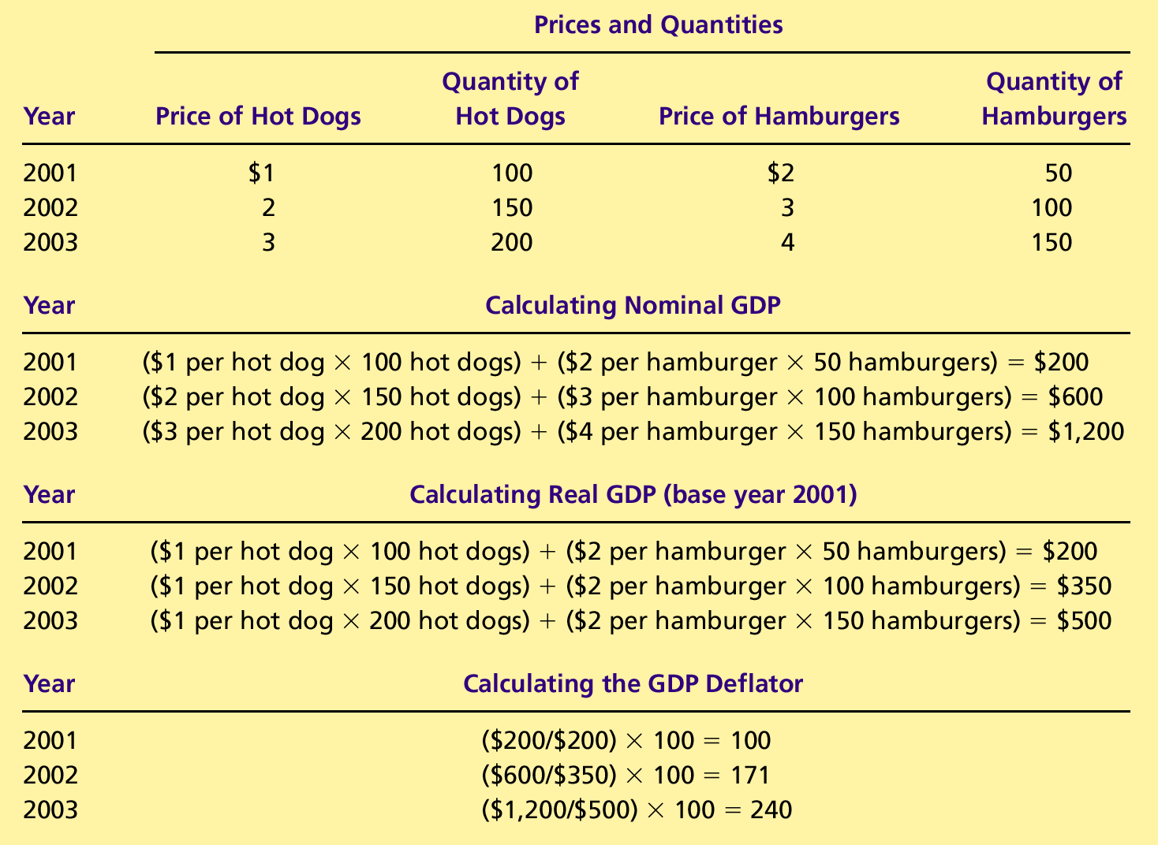
Table 2 Real and Nominal GDP
Copyright©2004 South-Western

Slide 22
Table 2 Real and Nominal GDP
Copyright©2004 South-Western

Slide 23
Table 2 Real and Nominal GDP
Copyright©2004 South-Western

Slide 24
The GDP Deflator
The GDP deflator is a measure of the price level calculated as the ratio of nominal GDP to real GDP times 100.
It tells us the rise in nominal GDP that is attributable to a rise in prices rather than a rise in the quantities produced.

Slide 25
The GDP Deflator
The GDP deflator is calculated as follows:

Slide 26
The GDP Deflator
Converting Nominal GDP to Real GDP
Nominal GDP is converted to real GDP as follows:

Slide 27
Table 2 Real and Nominal GDP
Copyright©2004 South-Western

Slide 28
GDP AND ECONOMIC WELL-BEING
GDP is the best single measure of the economic well-being of a society.
GDP per person tells us the income and expenditure of the average person in the economy.

Slide 29
GDP AND ECONOMIC WELL-BEING
Higher GDP per person indicates a higher standard of living.
GDP is not a perfect measure of the happiness or quality of life, however.

Slide 30
GDP AND ECONOMIC WELL-BEING
Some things that contribute to well-being are not included in GDP.
The value of leisure.
The value of a clean environment.
The value of almost all activity that takes place outside of markets, such as the value of the time parents spend with their children and the value of volunteer work.

